Slide 1
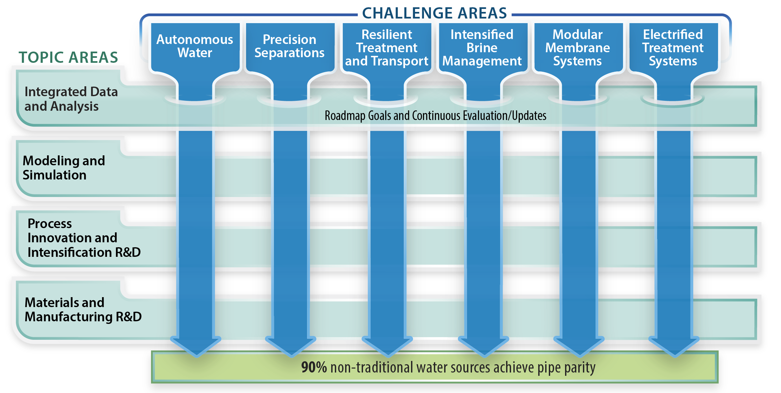

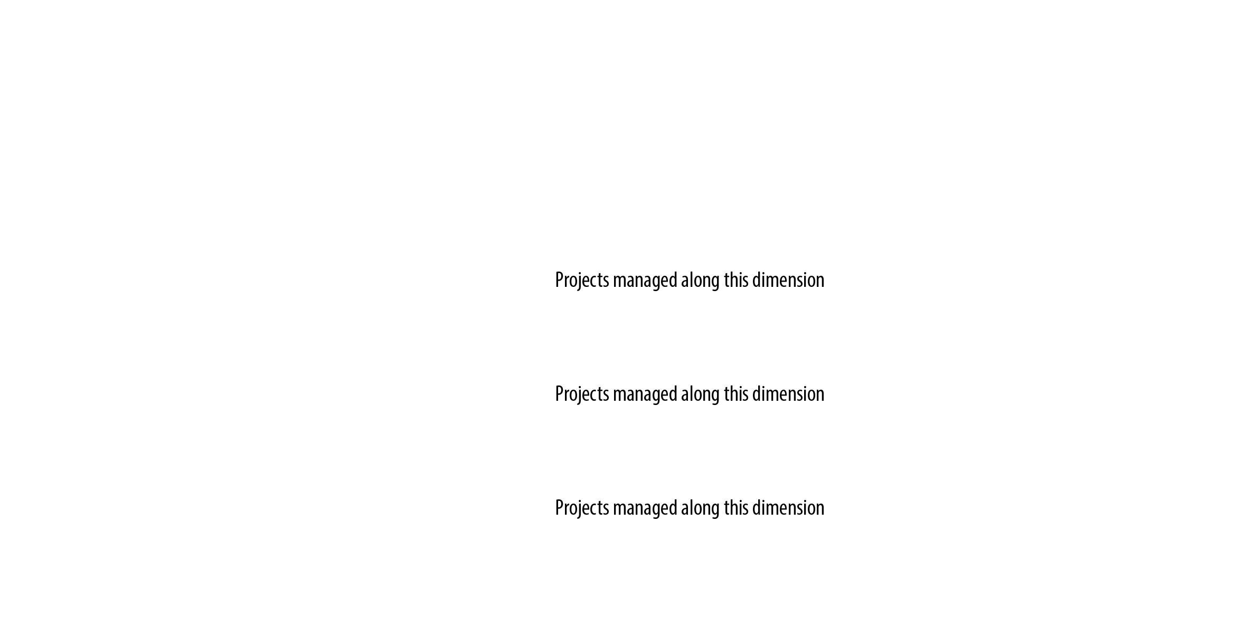
NAWI Topic Areas and Structure
Notes:
As peter alluded to, most desalination technologies relevant to large scale centralized facilities matured some time ago. Like the energy sector, however, water is moving into a decentralized future of local desalination and reuse. To ensure robust and secure water systems will require a significant and well integrated basic research effort. This effort covers length scales that span 12 orders of magnitude, from the implications of hydrogen bonding for membrane selectivity to the movement of water and water intensive goods through our economy. While this effort is low TRL, it is also deeply affected by economics, regulations, and public policies. The challenge is enormous and will require a massive, well focused, and closely coordinated R&D effort that integrates early stage applied research across the chemical, biological, material, computational, and data sciences.
The DOE’s leadership in advancing early stage applied research across the four topic areas of the hubs is evidenced in its investments in unique, powerful material characterization user facilities (such as Advanced Light Source at LBL, and Spallation Neutron Source at ORNL), leadership computing facilities, systems analysis and demonstration user facilities such as MDF.
To date, however, these tools haven’t been comprehensively or synergistically applied to address critical challenges in desalination research. Our topic area leadership is structured to efficiently leverage existing expertise for rapid progress toward pipe parity for non traditional waters. The four topic area leads are national lab scientists bringing disciplinary experience, while the four deputy leads are academics bringing domain knowledge and deep industry connections. In our proposal preparation efforts, this structure delivered a high impact research program that we are ready to, and excited about, executing on.

Slide 2

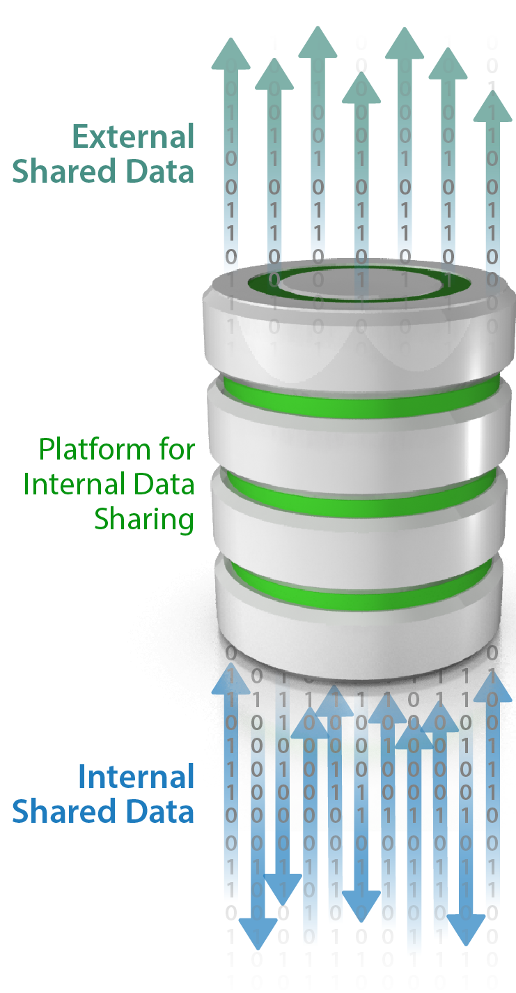
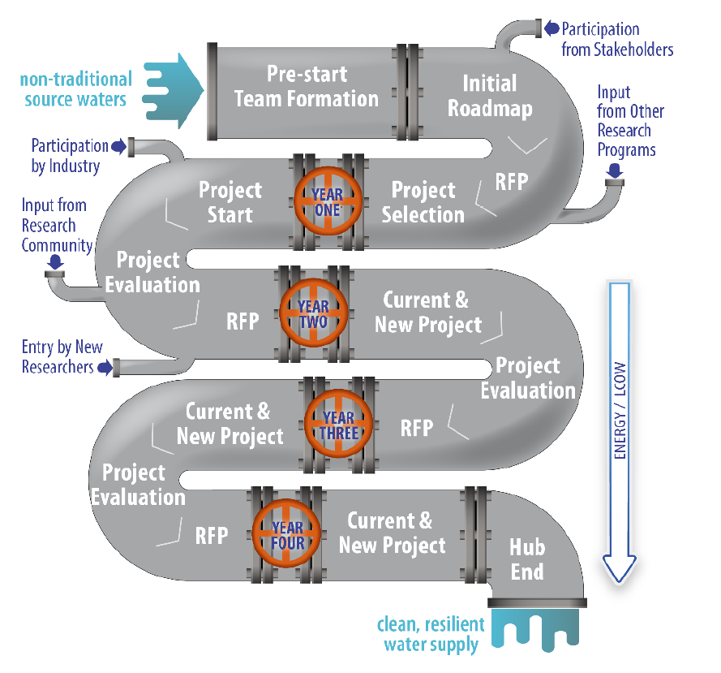
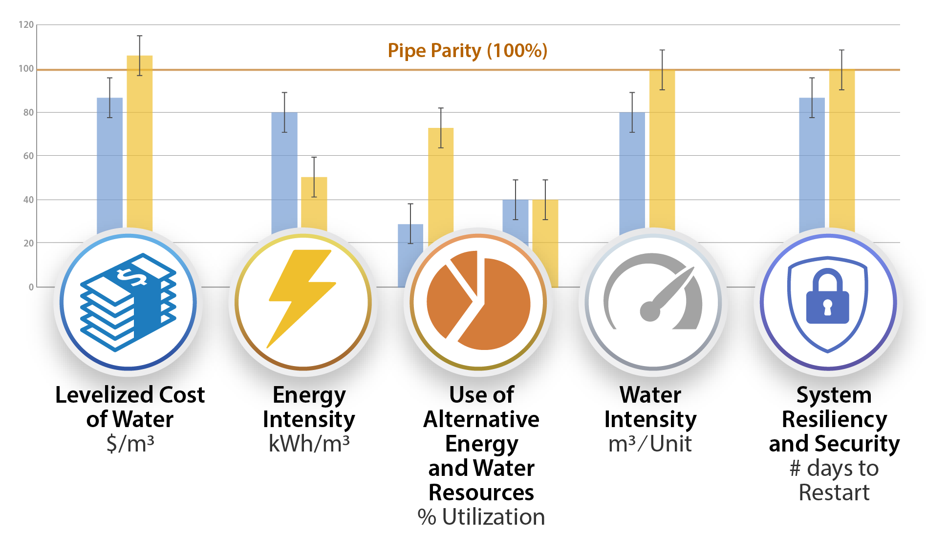
Integrated Data and Analysis GOAL: Prioritize early-stage R&D in water desalination in an unbiased and transparent process and provide foundational data and tools to the public.
Roadmap to R&D Cycle
Water Techno-economic Pipe Parity Platform (Water-TAP³)
Water Data and Analysis Management System (Water-DAMS)
Notes:
To make low TRL research impactful for today’s industries requires a systematic framework for assessing the value of innovation and quantitatively tracking R&D progress toward clear goals.
To deliver on this framework, we will use innovative data collection and estimation tools from remote monitoring systems to baysian probability models to harvest high and temporal resolution information about water treatment, use, and costs. This data will be secured using best practices deployed in NREL’s OpenEI framework that has already met DOE Cybersecurity requirements and support both internal and external data sharing.
This data will be used as inputs to a publically available systems analysis tool, entitled WaterTAP3, that provides a spatially resolved assessment of DOE’s five pipe parity metrics for nontraditional water sources. Think about this as the water equivalent of NREL’s systems advisory model for renewable energy deployment.
Finally, we will apply WaterTAP3 to perform baseline assessment, roadmapping, and project tracking throughout the duration of the hub.

Slide 3
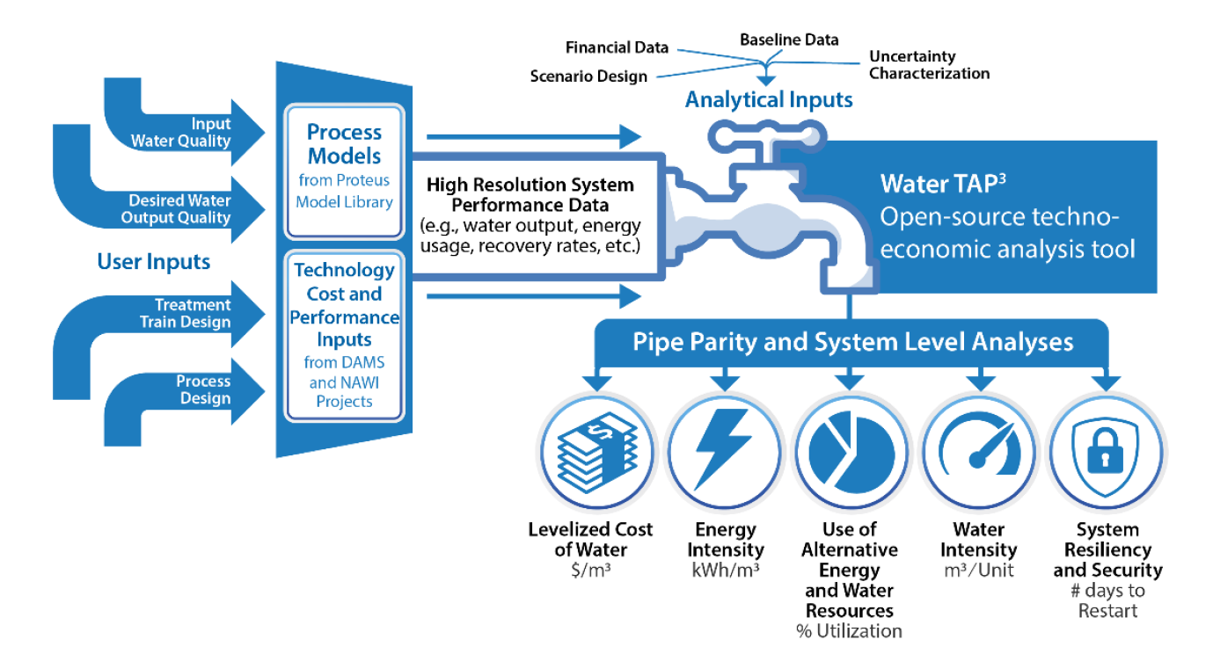
Integrated Data and Analysis– Water-TAP³
Project Summary
This task will build a single techno-economic evaluation platform that consistently benchmarks technologies and treatment trains across sectors, spatiotemporal contexts, and pipe parity metrics.
The Water Techno-economic Assessment Pipe Parity Platform (Water-TAP³) will provide a publicly accessible evaluation tool that will use open-source models and data housed in Water-DAMS. The final version will be a transparent, publicly available analytical tool that will be the national standard for calculating pipe parity comparisons of alternative water treatment technologies.
Notes:
This slide should be a basic introduction to the project including the title, topic area, team members, and high-level overview of the project.
Include at least one graphic that provides a visual representation of challenges and approach.

Slide 4
Integrated Data and Analysis– Water-TAP³
Challenges:
Existing techno-economic analysis (TEA) tools for water technologies fail to provide a consistent, cross-sector, spatiotemporally resolved basis for evaluating the diverse suite of pipe parity metrics that inform desalination technology selection. As a result, TEA tools are rarely used to prioritize early-stage R&D research in desalination.
Project Goals:
Develop the flexible Water-TAP³ platform to support NAWI baselining, roadmapping, and TEA studies and address TEA limitations in the water community
Develop suite of process models that can be used across source waters to calculate pipe parity metrics
Train a broad set of users on Water-TAP³ and TEA protocols to undertake consistent studies
Summary of R&D Approach:
Develop Water-TAP³ analytical platform
Develop a library of process models that are commonly used in water treatment systems
Train NAWI roadmapping teams on how to use Water-TAP³ and how to conduct TEA studies
Develop public-facing user interface and build user community
Document Water-TAP³ calculations, pipe parity metrics, and TEA approaches
Impacts and Benefits:
Water-TAP³ will provide a robust platform for evaluating water technology cost, energy and environmental trade-offs across water sources, sectors, and scales.
Water-TAP³ will provide quantitative, comprehensive pipe parity assessments early in the design process when the potential to make improvements is greatest.
It can also be used by policymakers, planners, and other researchers without extensive expertise through a publicly available graphical user interface. It will become the DOE- and industry-standard tool for undertaking water technology assessments, leading to more informed water investment decisions.
Notes:
For each M&M/PI&I project and major IDA or M&S task, complete this quad chart
Provide bullet or two that captures state of the art and critical barriers
Concisely summarize the goals and year one deliverable
Concisely summarize the R&D approach that will be taken to achieve project/task goals
Briefly describe the desired impact of the project in the context of the challenge and how, if met, achievement of goals will further future R&DS efforts in the water treatment space

Slide 5
Introduction to Water-TAP³

Slide 6




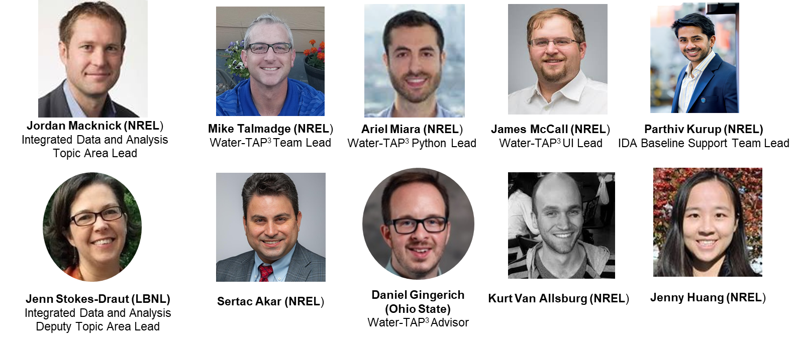
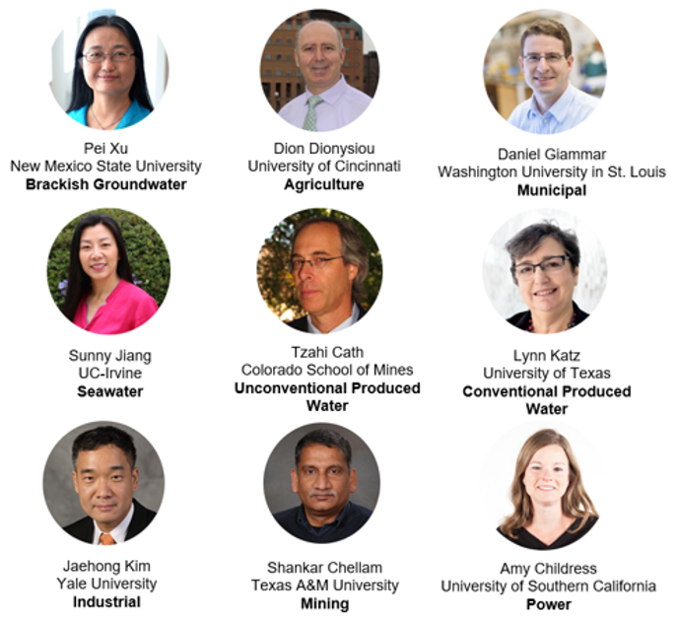
Water-TAP³ Team
IDA Leads Water TAP3 Team Cartographer Teams
Water-TAP³ team’s roles in NAWI Baselining and Roadmapping:
Develop the architecture and analytical framework for modeling NAWI pathways and quantifying Pipe-Parity metrics and uncertainties.
With other NAWI support teams, provide technical support for data collection efforts, Water-TAP³ basis development and pathway/model validations.
Cartographers teams are target audience and will serve as the primary source of development input as we work through development sprints, new releases and feedback cycles.
Notes:
The Water-TAP3 team is organized in the Integrated Data and Analysis effort withing NAWI, which is led by Jordan Macknick from NREL and Jennifer Stokes-Draut at Laurence Berkeley National Lab.

Slide 7
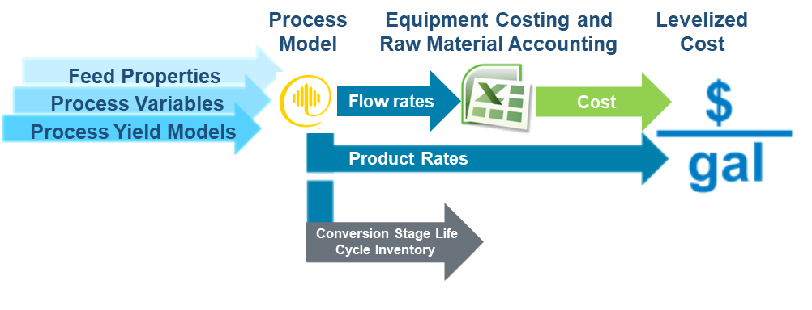
Intro to Techno-economic Analysis (TEA)
TEA is an approach for analyzing the technical and economic performance of a process, product or service that typically combines process modeling, engineering design and economic evaluation.
Levelized Cost and other Metrics
Within major R&D efforts, the TEA platform serves as the level playing field for comparative technology analyses and for quantifying and tracking R&D impact on cost, sustainability and other relevant metrics (pipe-parity metrics).
Notes:
Level playing field is consistent with that applied for DOE-funded R&D efforts.
Add note about other pipe-parity metrics near “Levelized Cost”

Slide 8
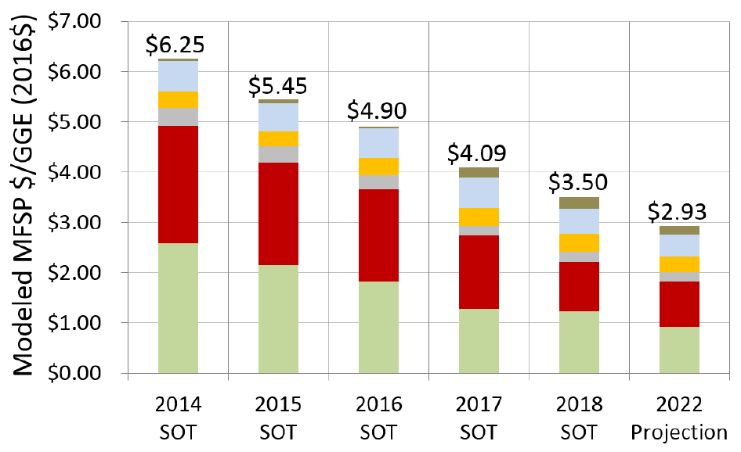
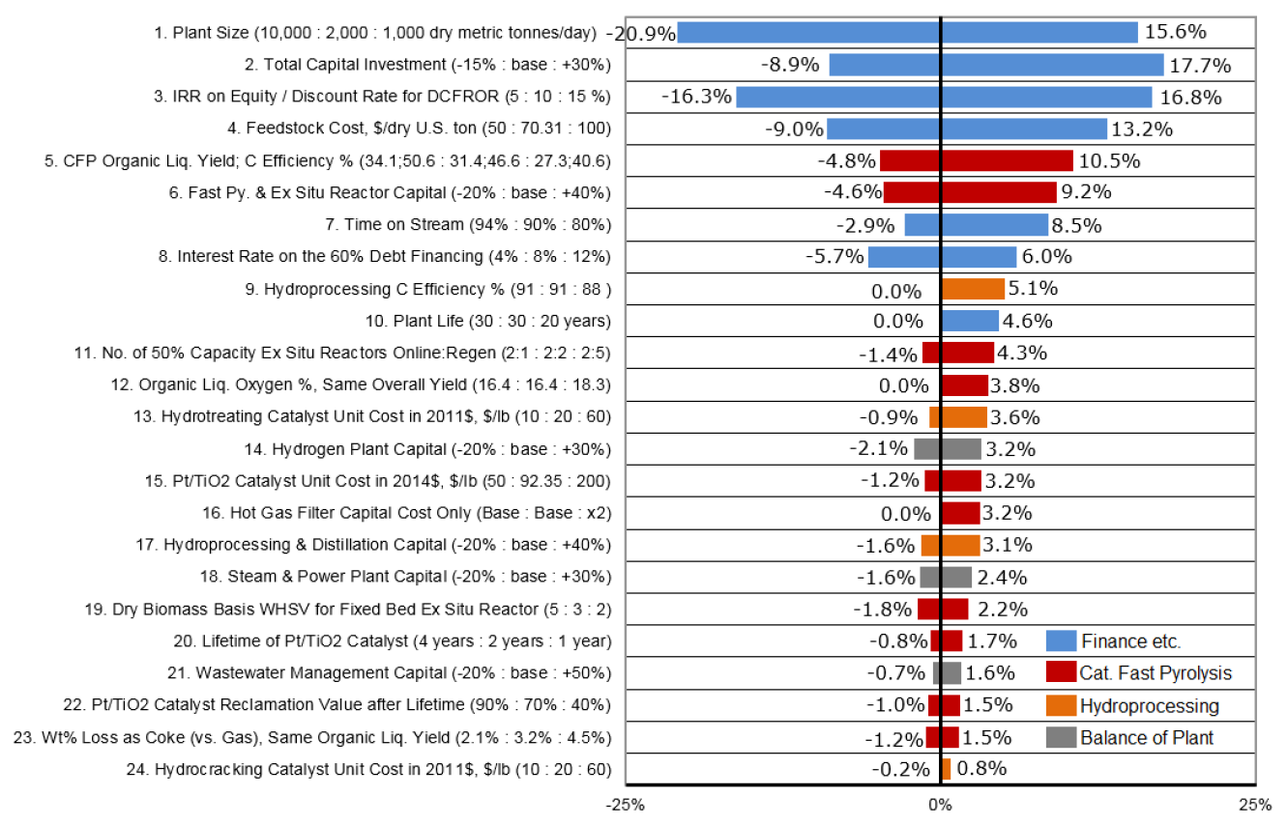
Intro to Techno-economic Analysis (TEA)
Primary steps in R&D-focused TEA:
Develop process basis with mass and energy balances.
Establish baseline scenario representing current state of technology.
Define research/cost targets and assess progress against current baselines.
Quantify current or potential future environmental sustainability metrics (LCI).
Perform sensitivity analysis to quantify impact of major variables on cost and sustainability.
Quantify uncertainty and financial risk.
Example ‘Waterfall’ Plot for Tracking R&D Impact
Source of example plots:
Dutta et al (2018) - https://www.nrel.gov/docs/fy19osti/71954.pdf
Example ‘Tornado’ Plot from Sensitivity Analysis

Slide 9
Data Utilized for TEA
Major Elements of TEA | NAWI Data Examples
Boundary conditions to define inputs and target outputs. | Source water and target use properties, locations and volumes.
Process basis to establish water, contaminant and chemical balances. | Process flow diagram (PFD), heat and material balances, manufacturer data sheets, other water process models.
Capital costs for cash-flow analysis and LCA basis. | Capital cost curves for processes, major equipment, other published TEA articles and models.
Material consumption rates and operating costs for cash-flow analysis and LCA basis. | Material balances, manufacturer data sheets, other published TEA articles and models.
Pricing data for feeds, raw materials, replacement parts utilities, waste, products, etc. | Published data for treatment chemicals, vendor quotations for replacement parts.
Other data | Emission factors for chemicals, uncertainties/distributions, cost indices, unit conversion factors, operational reliability/resiliency, electricity mix.
Notes:
You’ll see in the model that there are places for lots of data. Together with other NAWI support teams, the Water-TAP3 will assist in developing modeling basis data with the Cartographer teams.

Slide 10
Water-TAP³ Vision and Year-1 Goals
Objective: Develop the Water-TAP³ architecture and analytical framework for modeling NAWI pathways and quantifying Pipe-Parity metrics and uncertainties.
Water-TAP³-Excel designed for Proof-of-Concept in Baseline and Roadmapping analysis.
Perform collaborative work with NAWI teams on framework and adding process basis data.
Compare process technologies on basis of cost, process efficiency, env/social impact, water intensity, etc.
Create user-defined processes to assess technology advancements.
Perform sensitivity analysis and quantity uncertainty of results.
Identify essential use cases and limitations to inform Python development.
Water Technoeconomic Analysis and Pipe Parity Platform
Vision
Initial Water-TAP³-Python will be integrated with public user interface

Slide 11
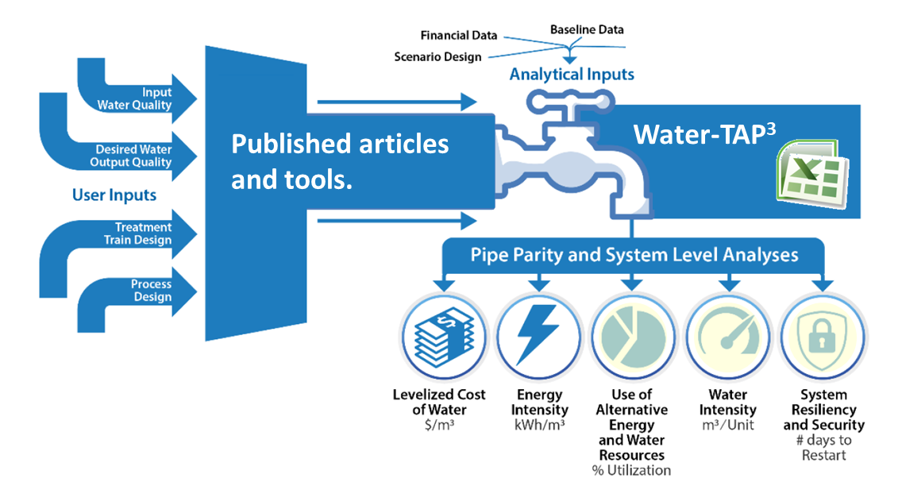
Water-TAP³ Vision and Year-1 Goals
Objective: Develop the Water-TAP³ architecture and analytical framework for modeling NAWI pathways and quantifying Pipe-Parity metrics and uncertainties.
Water-TAP³-Excel designed for Proof-of-Concept in Baseline and Roadmapping analysis.
Perform collaborative work with NAWI teams on framework and adding process basis data.
Compare process technologies on basis of cost, process efficiency, env/social impact, water intensity, etc.
Create user-defined processes to assess technology advancements.
Perform sensitivity analysis and quantity uncertainty of results.
Identify essential use cases and limitations to inform Python development.
Water Technoeconomic Analysis and Pipe Parity Platform
Today
Initial Water-TAP³-Python will be integrated with public user interface

Slide 12
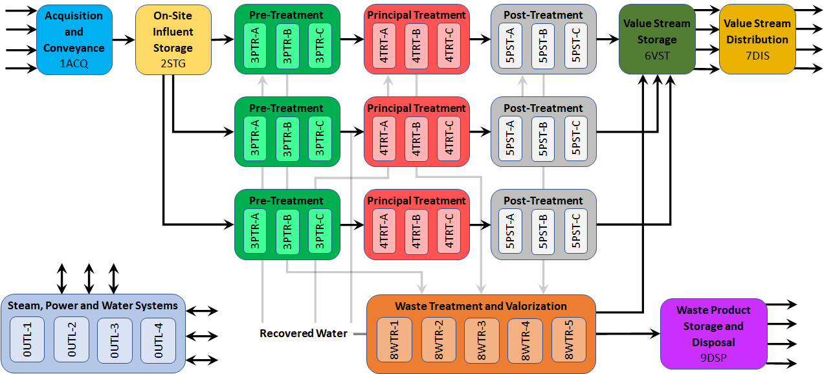
Water-TAP³_{Excel} V02 Framework
12

Slide 13
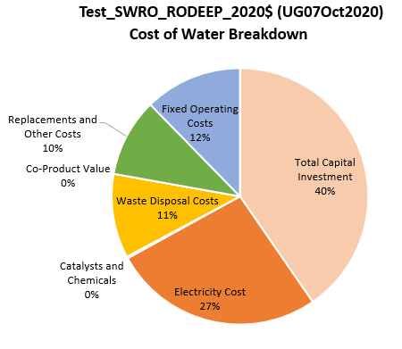
Water-TAP3 Capabilities
Current Excel Model
Treatment train configurations identified in case studies.
Sensitivity analysis
Case stacking
Monte Carlo uncertainty analysis
Output data summary and visualizations (in-progress)
Future Python Model
Multi-objective function optimization
Time-series scenario modeling
Integration with ProteusLib (i.e. Aspen for Water), Water-DAMS and Public-Facing UI

Slide 14
Water-TAP3 Outputs
Levelized cost of water
Energy intensity
Total water intensity
Environmental impacts
Other pipe parity metrics are under development

Slide 15
Current Status of Water-TAP³
Ready for the NAWI analysis "proof-of-concept".
Stability for version control and saving base scenarios for case studies.
Most recent (functioning) version of the Excel tool will be saved here ==> https://collab.openei.org/67/water-tap3/model.
Subsequent versions of the tool will have current case studies saved.
As scenarios are completed, teams will engage on analysis needs.
Documentation is ongoing with model development.
Finalizing needed calculations for energy, water, environmental metrics.
Shifting team focus to Python.
15

Slide 16
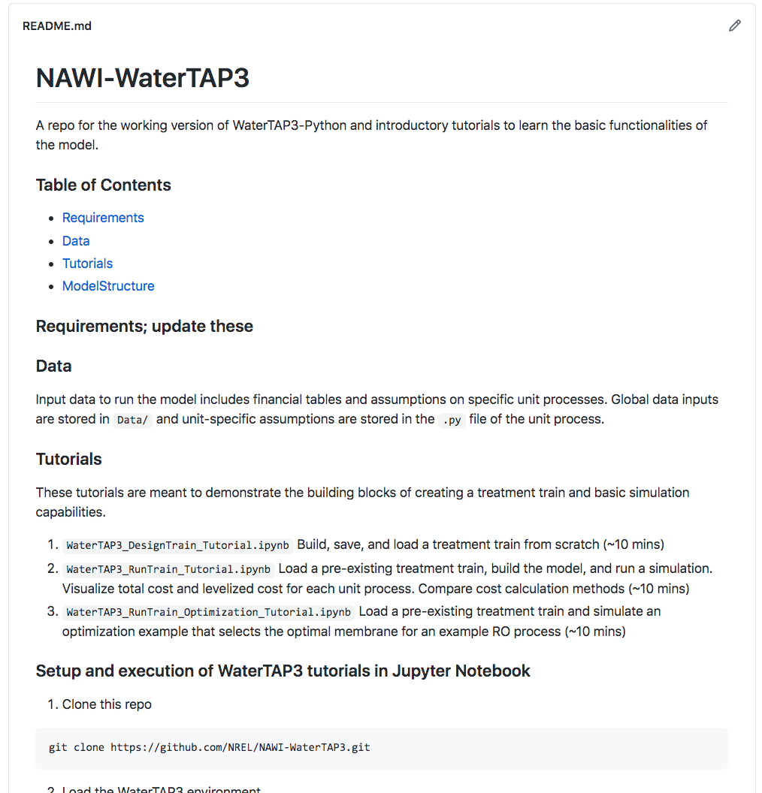
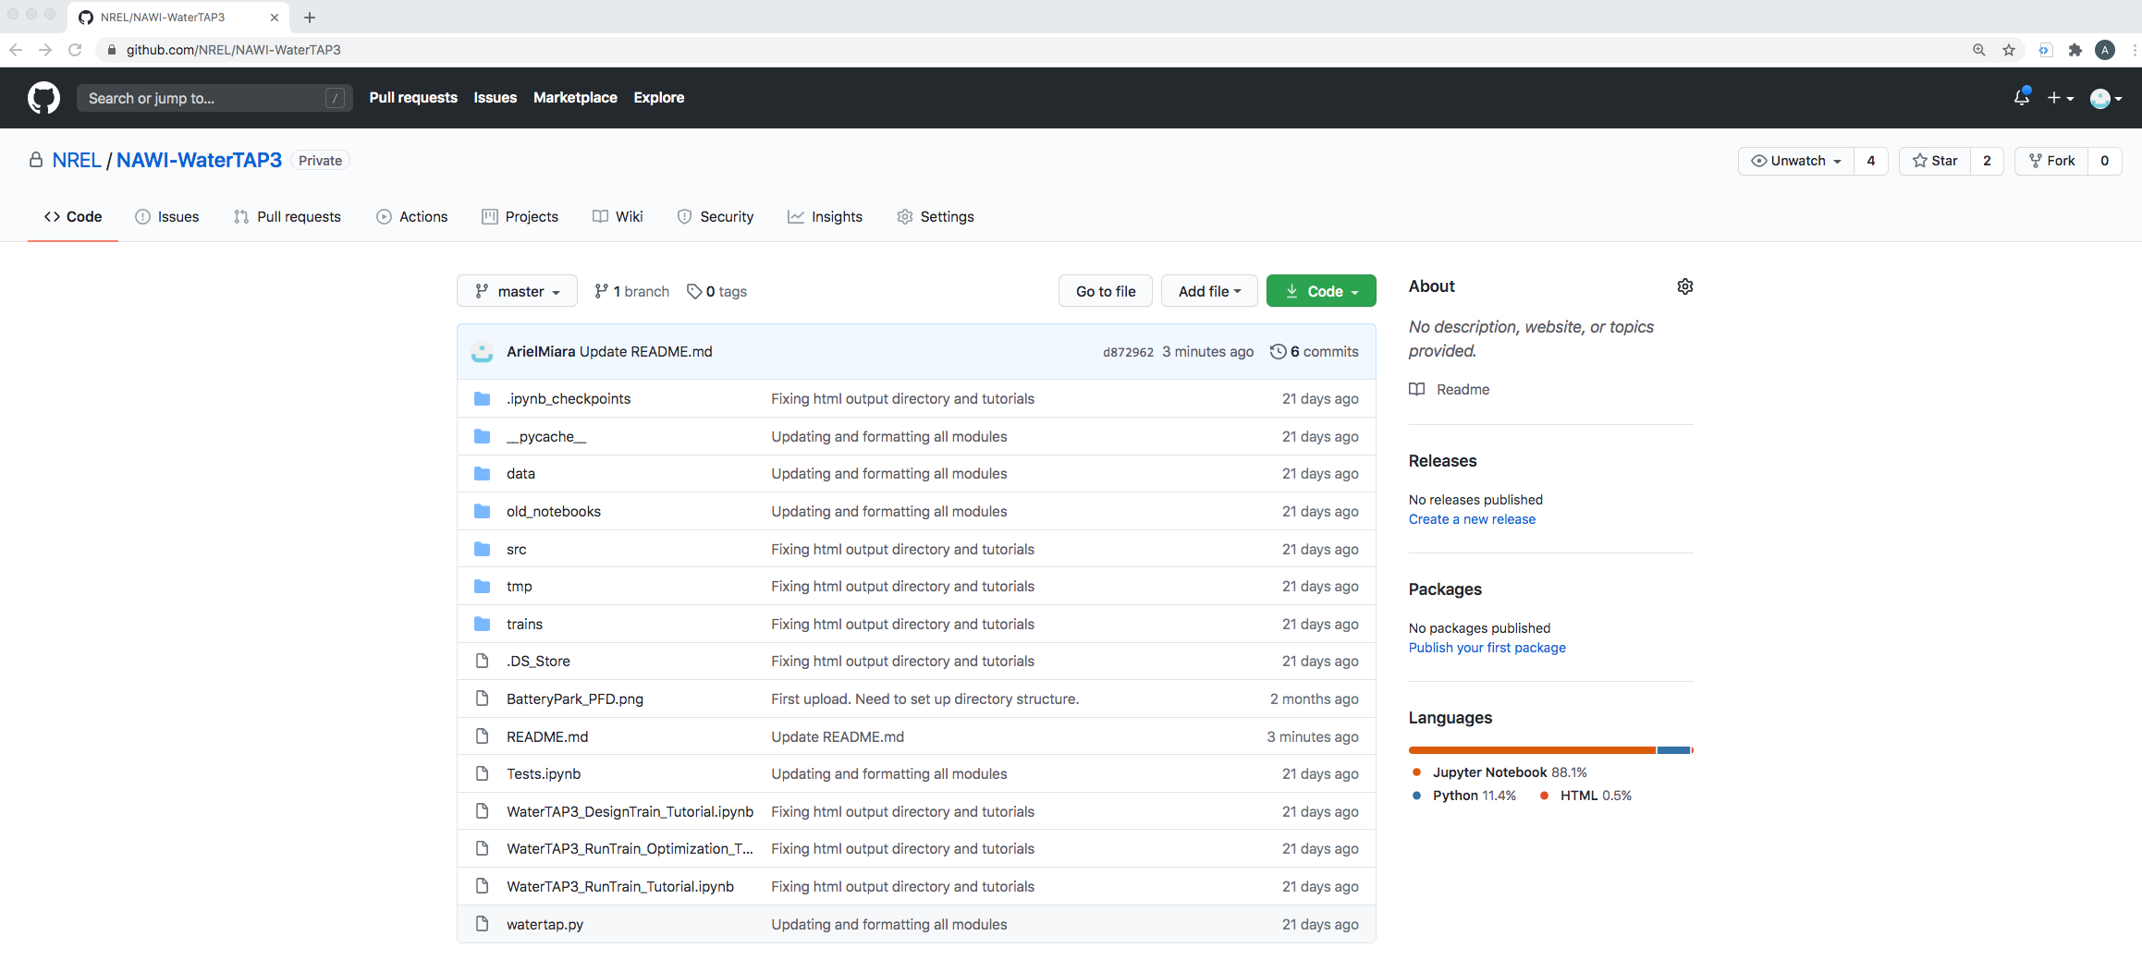
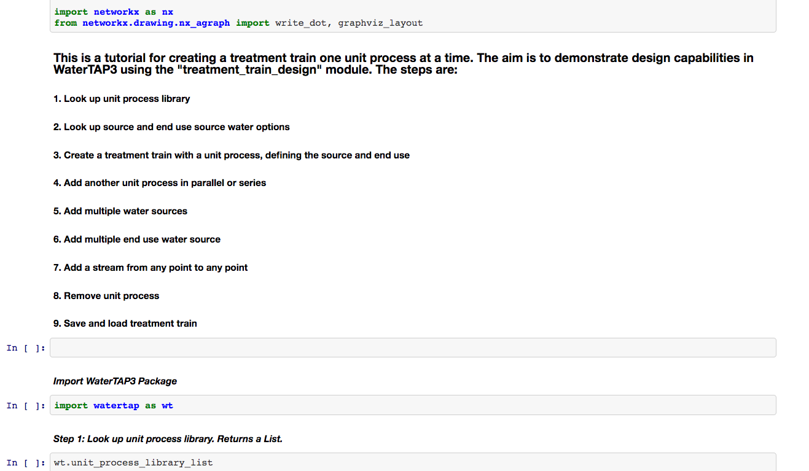
Current Status
Working version is on GitHub and has been shared with the Proteus team.
Represents a handful of unit processes.
Three tutorials designed to show basic functionalities.

Slide 17
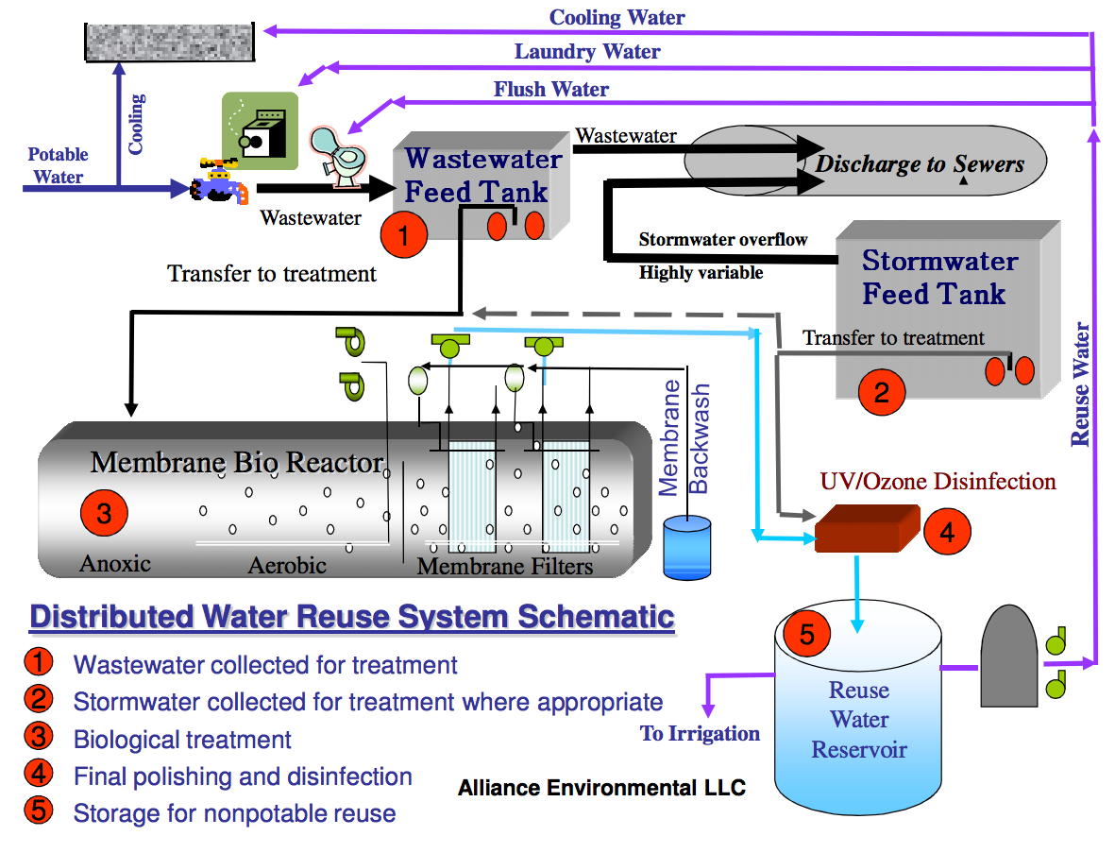
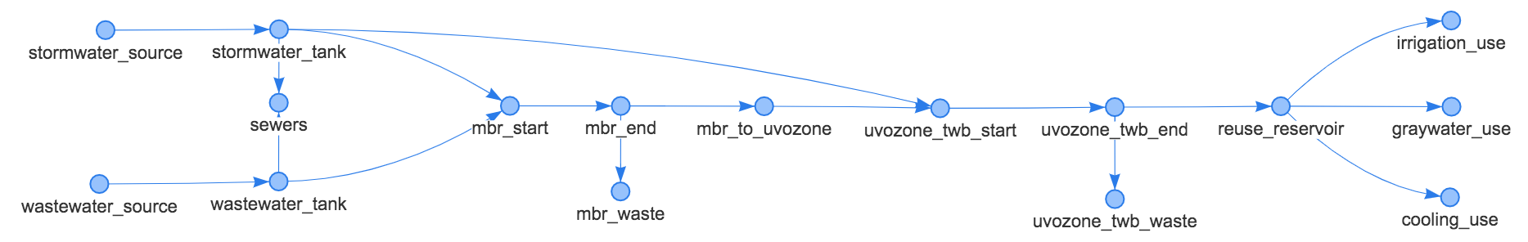
Water-TAP3 Model Framework
Model framework is based on network topology
Should allow us to represent any combination of unit processes and flows between them
Will enable optimization options for selecting pre-existing treatment trains, creating a treatment train based on source and end use requirements, and selecting some specifications of a unit process (i.e. membrane for RO process).
Consistent to fit with IDAES framework and planned approach for Proteus
Example of the Battery Park process flow diagram captured in the WaterTAP3 Python model framework.
Representation in WaterTAP3

Slide 18
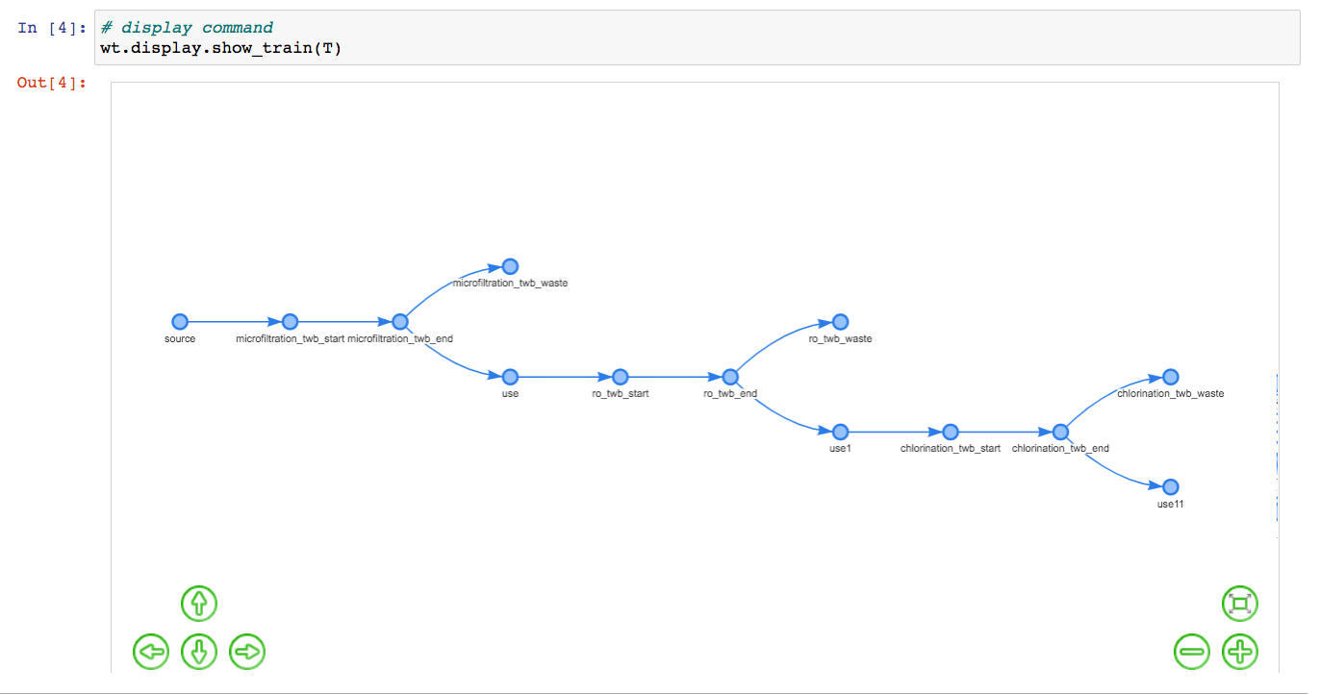
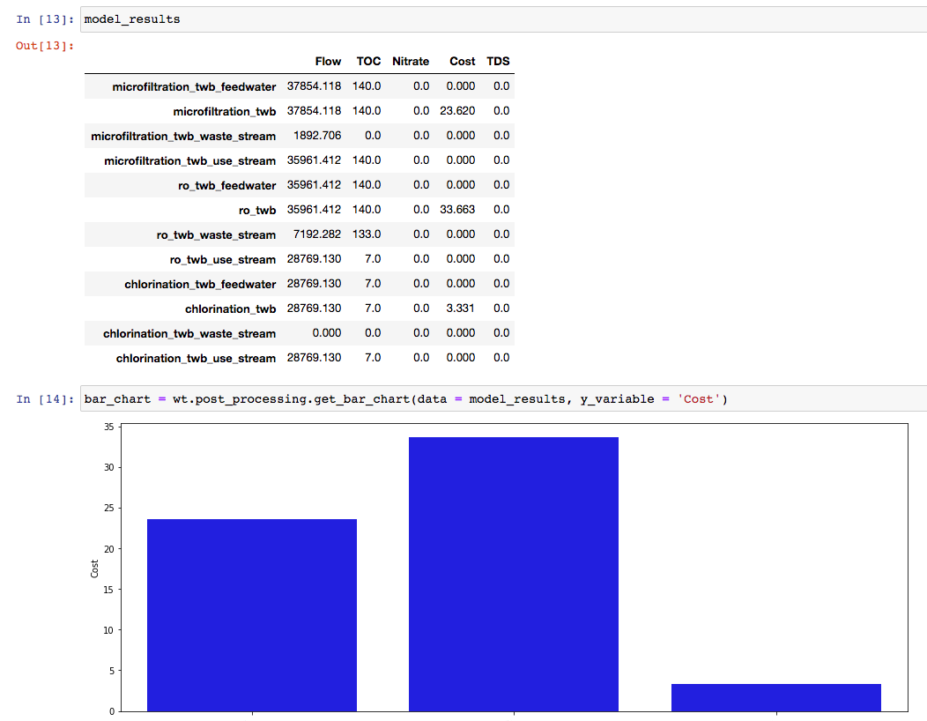
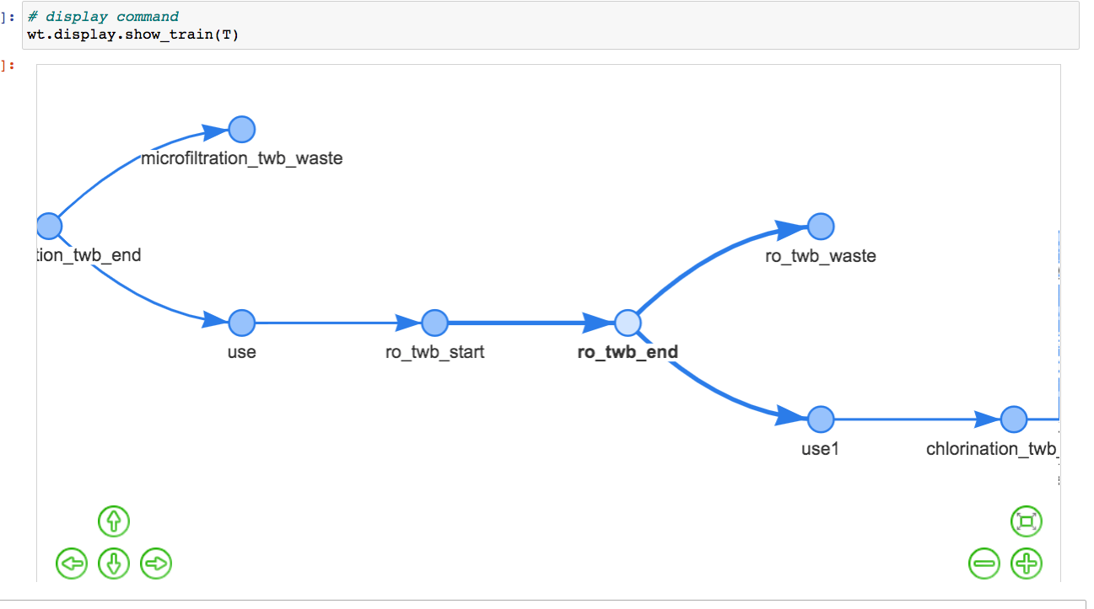
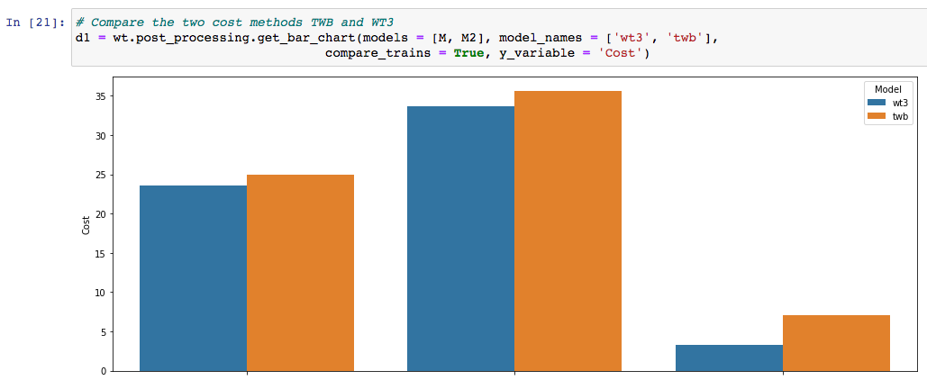
Water-TAP3 Capabilities
Microfiltration
RO
Chlorination
Model framework is based on network topology
Water source and use case study library
Users can load pre-existing case study water sources (currently has Poseidon case study examples)
Model currently represents a sub-set of Excel unit processes
Chlorination, media filtration, microfiltration, ultrafiltration, nanofiltration, UV, chlorination
Reverse osmosis methods: Texas Water Board, Bureau of Reclamation, DEEP
Contains list of membranes options
As with Excel, calculates unit-process level costs and flows
Has the option of comparing costs calculation methods/options
Cost ($MM)
RO
Microfiltration
Chlorination
Cost comparison across methods
WaterTAP3
Texas Water Board
Cost ($MM)
RO
Microfiltration
Chlorination

Slide 19
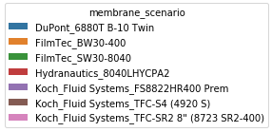
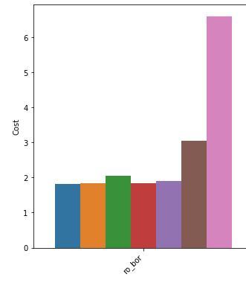
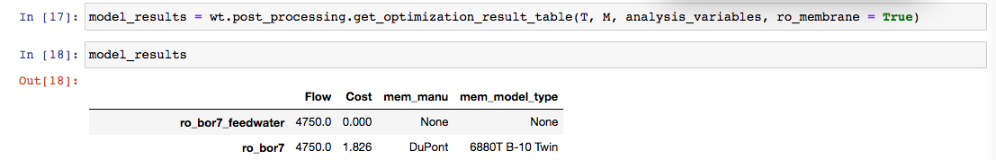
Water-TAP3 Capabilities
Microfiltration
RO
Chlorination
Model framework is based on network topology
Water source and use case study library
Model currently represents a sub-set of Excel unit processes
As with Excel, calculates unit-process level costs and flows
Has the option of comparing costs calculation methods/options
Sensitivity analysis: Monte Carlo
500 simulations in < 2mins (faster than Excel but turtle speed for Python?)
Optimization
- Example of selecting membrane
Monte Carlo example:
Capital scaling exponent
RO
Microfiltration
Cost ($MM)
Capital scaling exponent
RO
Optimization example: selection of least-cost membrane

Slide 20
Water-TAP3 process model status
Pretreatment
Conventional Activated Sludge (CAS)
CAS with Nitrification
CAS with Denitrification
Membrane Bioreactor (MBR)
MBR with Nitrification
MBR with Denitrification
Media Filtration (P)
Deep Bed Filtration
Bio-Active Filtration
Chemical Additions
Coagulation and Flocculation (P)
Tri-Media Filtration with Backflush
Cartridge Filtration with Backflush
Principal Treatment
Micro-Filtration (P)
Ultra-Filtration (P)
Nano-Filtration (P)
Reverse Osmosis – IAEA DEEP 5.1
Reverse Osmosis (P)
Chemical Additions
Membrane Distillation
Multi-Effect Distillation
Multi-Stage Flash
Mechanical Vapor Compression (MVC)
Post Treatment
Lime Softening (P)
Chlorination (P)
Ozonation
Ozonation with AOP
UV Irradiation
UV Irradiation with AOP
Soil Aquifer Treatment
Surface Augmentation
Engineered Buffer + Chlorine
Engineered Buffer + Chloramine
Chemical Additions
Ion exchange
Electrodialysis reversal (EDR)
Electro deionization (EDI)
Electrodialysis (ED)
Electrodialysis with bipolar membrane (EDBM)
Capacitive deionization (CDI)
Waste Disposal
Salinity Management Pipeline
Evaporation Pond
Direct Injection
Deep Well Injection
Direct Discharge
Stream Augmentation
Landfill
Concrete
Hazardous Waste
Radioactive Waste
Waste Valorization
Lithium recovery
Zero Liquid Discharge
- Evaporation
- Crystallization
- Vacuum Belt Filtration
Soil amendment recovery
Biogas recovery
Biosolids recovery
Anaerobic Digestion
Energy Efficiency/Recovery
Geothermal power
Geothermal heat recovery
Concentration solar power
On-site solar power
Biogas combustion
Combined heat and power
Black text indicates completed process models
Red text indicates process models not yet completed
(P) Indicates Proteus team near-term development goal

Slide 21
Validation Activities
Case validations with other published cost data sources and other modeling tools.
Independent municipal case study validations by Alison Sim from Dr. Meagan Mauter’s team at Stanford.
NAWI Water-TAP3 Project Support Group.
Literature search results for existing water technology TEA and LCA (currently ~150 studies).
Engagement with external consultants.

Slide 22
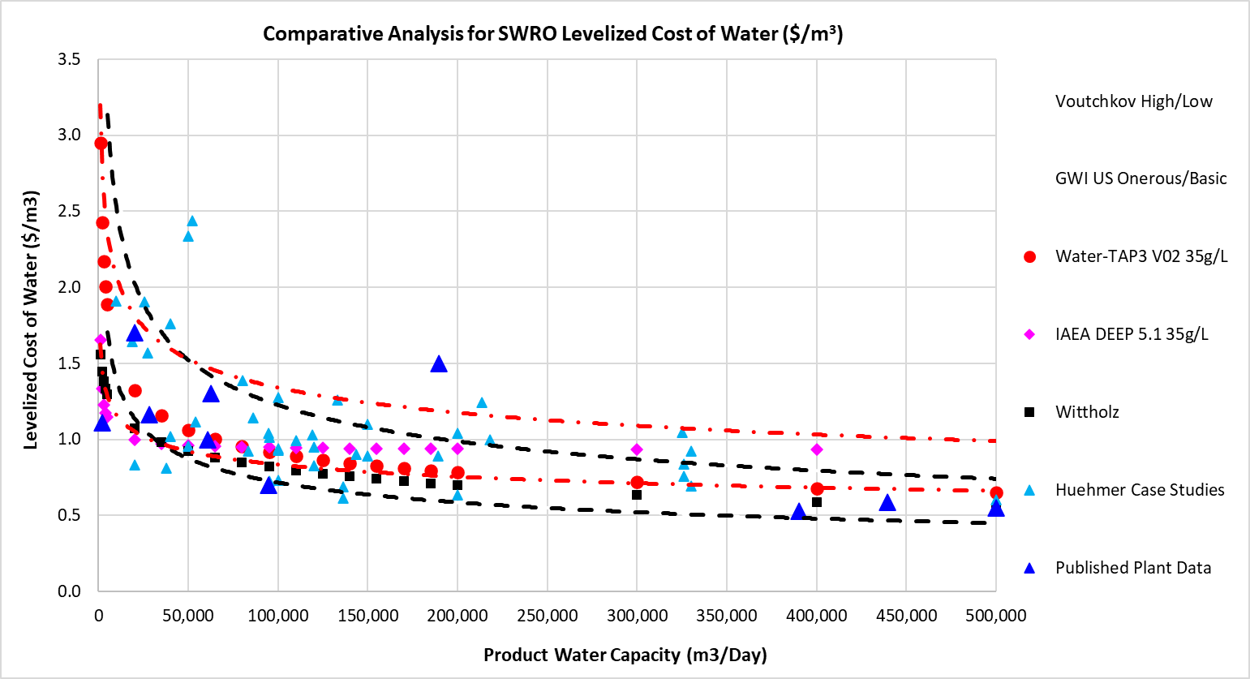
SWRO Comparative Analysis with Published and Modeled Sources

Slide 23
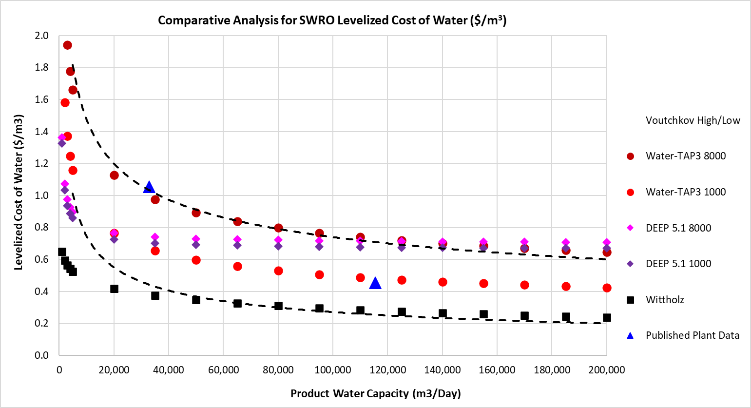
BWRO Comparative Analysis with Published and Modeled Sources

Slide 24
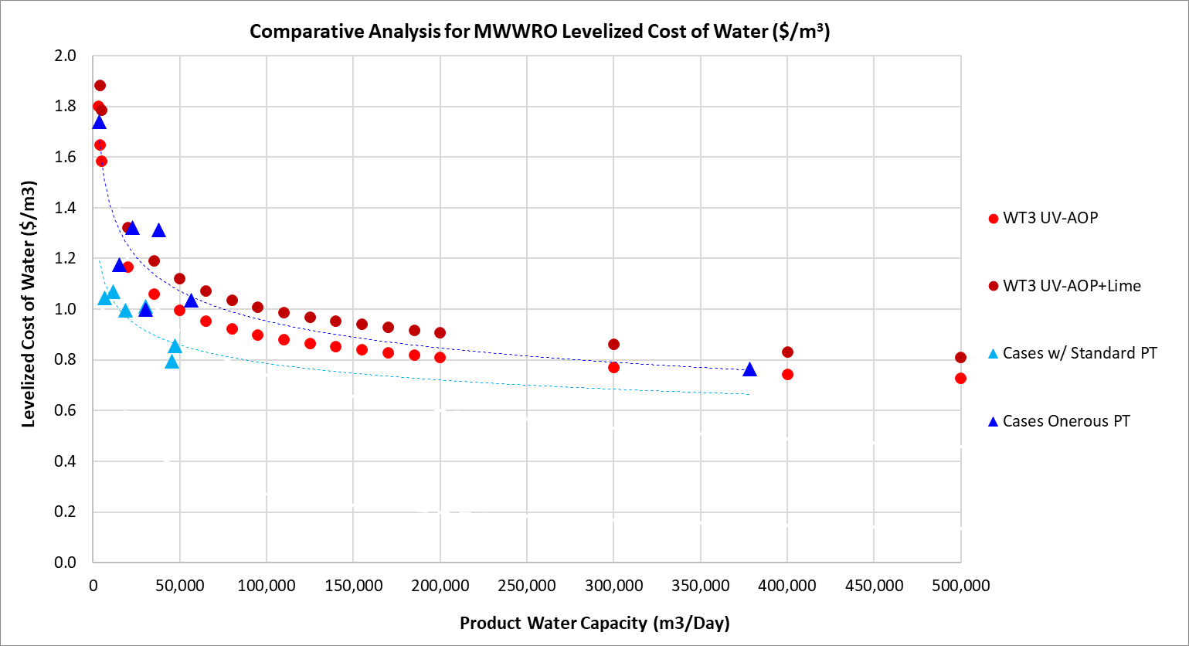
MWWRO Comparative Analysis with Published and Modeled Sources

Slide 25
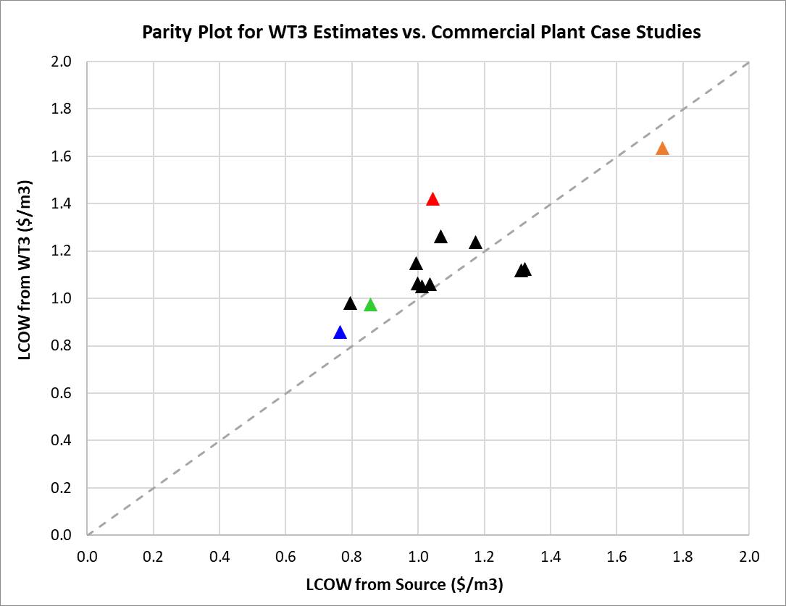
MWWRO Comparative Analysis with Published Cases
Commercial Cases Reviewed by Alison Sims
Carpinteria Valley Water District
Big Spring Colorado River Municipal Water
City of Pismo Beach Central Coast Blue
Pure Water Oceanside
Pure Water Monterey
City of Oxnard
Los Alamitos Barrier Water Replenishment (*)
Santa Clara Valley Water
El Paso Advanced Water Purification Facility
Dominguez Gap Barrier (*)
West Basin Edward C Little Recycling (*)
Groundwater Reliability Improvement Project
Orange County Groundwater Replenishment (*)
error range: -15% / +35%
target range: -30% / +50%

Slide 26
Water-TAP³ Next Steps
Excel and Python
Continue to support NAWI Baselining/Roadmapping analysis needs with Excel model.
Demonstrate Python model and incorporate relevant basis data from Excel work.
Develop use cases in collaboration with Cartographer and NREL Support teams.
Continue to develop needed Process Models for current and future analysis needs.
Add other pipe parity metrics with emphasis on reliability, robustness, wastes and emissions.
Validate the model results for process calculations, LCOW, energy intensity and other PPM.
Python Only
Enable assessments with performance degradation and modeled time-series events.
Enable decentralized and mobile system calculations and benefits analysis.
Integrate Python model with ProteusLib, Water-DAMS and Public-Facing UI
BP-1
BP-2
26

